Slide 1

G MADEGOWDA INSTITUTE OF TECHNOLOGY BHARATHINAGARA, MADDUR TALUK, MANDYA DISTRICT-571 422 Department Of Computer Science & Engineering
2024 - 25
Presented by:
Rajesh C P [4MG21CS038]
Anirudh H [4MG22CS400]
Shashank K S [4MG21CS044]
Harish Kumar S [4MG21CS018]
Under the Guidance of :
Dr. Radhakrishna K R
Professors
Dept of Computer science & Eng

Slide 2
Ayurvedic plant leaf classification using machine learning

Slide 3
Introduction to Medicinal Plants
Medicinal plants have been used in traditional medicine for centuries.
They contain bioactive substances for treating various ailments.
There's a growing demand for natural products and sustainable healthcare.
Correct identification of these plants is crucial for effective use.
ML/DL offers promise in identifying and classifying them.

Slide 4
The Challenge of Identification
Identifying medicinal plants can be difficult.
Many species have similar physical characteristics.
Environmental factors affect their chemical makeup.
Traditional methods are time-consuming and subjective.
Manual identification is prone to errors.
This poses a challenge for those with limited botanical knowledge.

Slide 5
Machine Learning to the Rescue
ML/DL algorithms can classify medicinal plants.
This is based on the physical characteristics of their leaves.
Image processing extracts relevant features.
Features include texture, shape, and color.
ML/DL models learn patterns to distinguish species.

Slide 6
Advantages of ML/DL
ML/DL can process large amounts of data quickly.
They can identify many different plant species.
Algorithms detect subtle morphological differences.
This leads to more accurate classification.
They offer a more efficient approach than traditional methods.

Slide 7
Examples of ML/DL Applications
CNNs have been used to classify medicinal plants.
One study used CNNs to classify seven different plants.
Another study used texture and shape features to classify
12 plants.
ML can also be used to classify different species of
medicinal plants.
These methods show high accuracy in plant identification.

Slide 8
CNN Architecture
CNN is a deep-learning model designed to process grid-like data, such as images. It consists of three key types of layers:
Convolutional Layer: Extracts features from the input image by applying filters (kernels) to detect patterns like edges, textures, and shapes.
Pooling Layer (Max Pooling): Reduces the size of the feature maps, selecting the most prominent features while retaining spatial information.
Fully Connected Layer: Flattens and maps the extracted features to output neurons, helping in final classification

Slide 9
Applications of Medicinal Plant Classification
Detecting adulteration and substitution of plants.
Ensuring the quality and safety of herbal medicines.
Identifying new plant species with medicinal potential.
Discovering new natural medicines.
Revolutionizing herbal medicine.

Slide 10
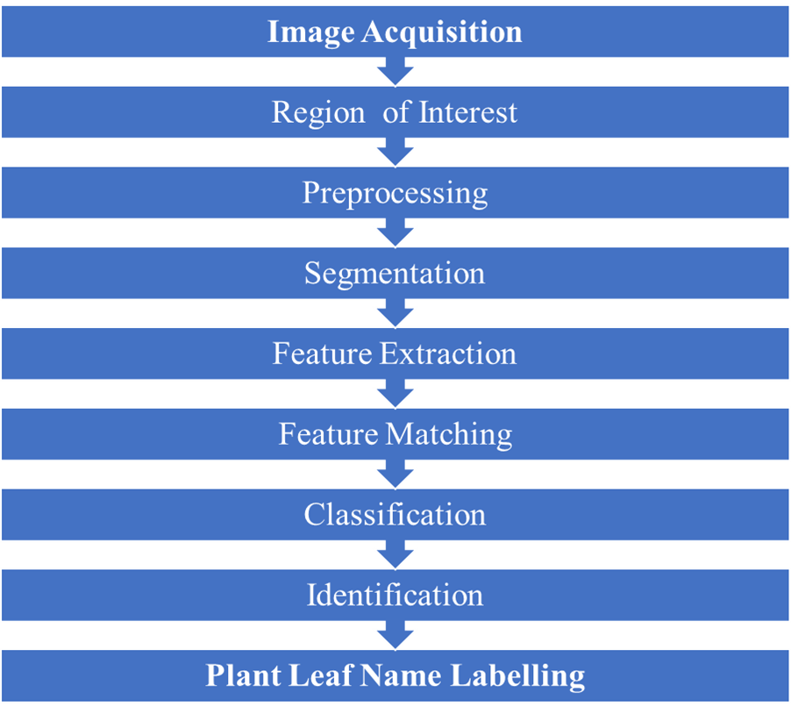
Flowchart of leaf classification

Slide 11
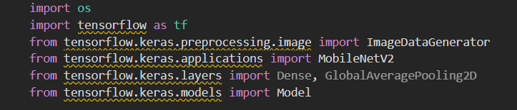
Import inbuilt functions

Slide 12
Problem Statement
Accurate identification of medicinal plants is challenging.
This is due to the large number of species and variations
in morphology.
Traditional methods are time-consuming and expensive.
There is a need for efficient systems using ML/DL.
Such systems can analyze visual features to identify plants

Slide 13
Objectives of the Project
Develop an efficient method for identifying medicinal
plant species.
Preprocess collected images and use data augmentation.
Utilize deep learning models like CNNs.
Evaluate the model using validation sets and metrics.
Develop a user-friendly web application for classification.

Slide 14
Literature Review - Image Analysis
Images convey valuable information for recognition tasks.
Computers find it challenging to extract features from images.
Systems need training with a dataset for accuracy.
Recognition accuracy is crucial for plant identification.
Automatic plant recognition systems are important.

Slide 15
Existing Systems
Existing systems rely on manual efforts or basic
image processing.
Botanists use physical inspection and taxonomical guides.
Some digital systems use basic image recognition.
These are constrained by predefined rules and
limited datasets.

Slide 16
Disadvantages of Existing Systems
Inaccuracy in distinguishing similar leaf structures.
Time-consuming manual methods.
Limited scalability for diverse geographical regions.
Sensitivity to lighting and background noise.
Dependency on trained botanists.

Slide 17

Proposed System
Develop a robust ML-based system.
Accurate detection and classification of medicinal
plant leaves.
Use CNNs for feature extraction and classification.
Train the model on a large dataset.
Implement pre-processing to handle environmental variations.
Develop a mobile application for users.

Slide 18
System Requirements - Functional
Detect and classify leaves from an image input.
Classify leaves into predefined categories of
medicinal plants.
Provide detailed information about identified plants.
Enable offline functionality.

Slide 19
System Requirements - Non-Functional & Hardware
Target accuracy of over 95%.
Real-time detection with minimal lag.
Scalability to expand with new species and datasets.
Intuitive interface for non-technical users.
Camera-enabled device for capturing images.
Computing device with GPU for model training.

Slide 20
THANK YOU

